Slide 1
Chapter 25 & 26
Magnetic Field
Magnetic Flux and Gauss’ Law
The Magnetic Force on a Particle
Magnetic Force on a Current-Carrying Wire
Magnetic Field Due to Current
Ampere’s Law
Magnetic Materials

Slide 2
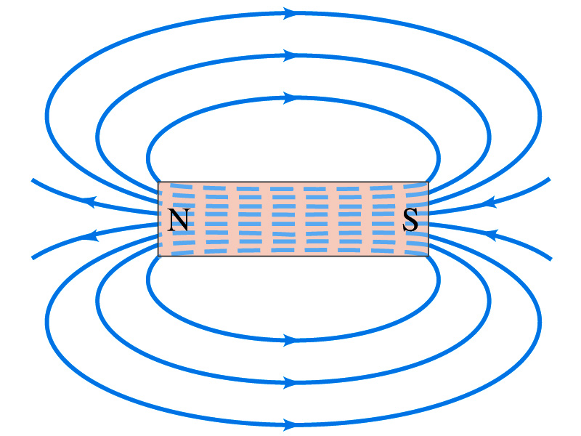
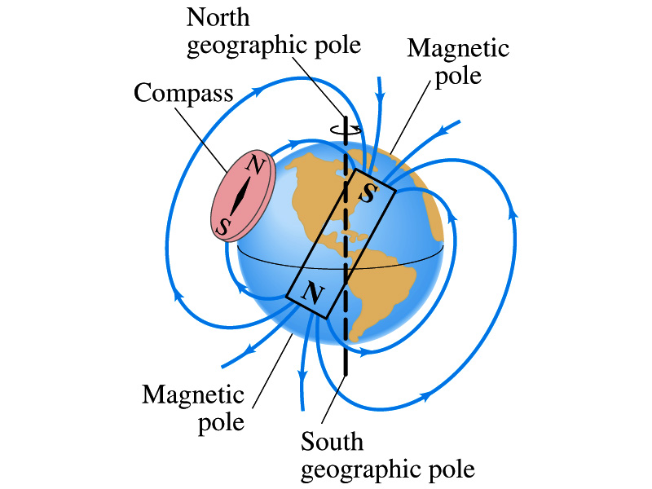
25-1.The Definition of (P580)
Magnetic phenomena:
Magnets used in: compass; refrigerator-door;
microphone; computer disk; …
I

Slide 3
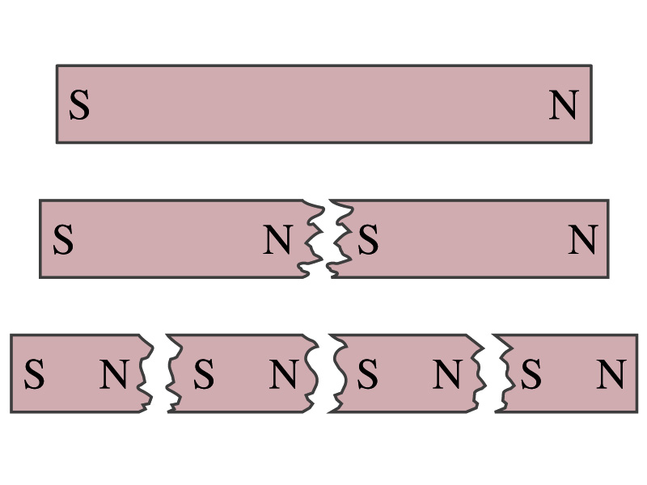
A electric charge set up an electric field that can affect other electric charges. Might you expect that a magnetic charge set up a magnetic field that can then affect other magnetic charges? Such magnetic charges are called magnetic monopoles, which are predicted by certain theory, although their existence has not been confirmed.
The interacting force between moving charges is magnetic force which is transferred by magnetic field (运动电荷之间的相互作用力---磁力,由磁场传递).

Slide 4
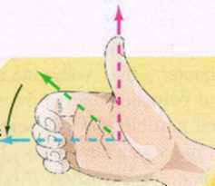
moving charges
magnetic field
moving charges
In a similar way as the definition of electric field, we could define by the acting force of magnetic filed on the moving charges as:
The magnitude of :
(P586)
The direction of is along the zero-force.
The magnetic force is:
α
+q
—— Lorentz’s force

Slide 5
An equivalent way to define in terms of the force on electric currents is discussed in Sec.25-3 (P583).
SI unit: tesla (特斯拉) (T), gauss or N/(A·m).
地磁场B_{earth} ≈ 5×10⁻⁵ T
Dimension: I⁻¹MT^{–2}.
The principle of superposition of :

Slide 6
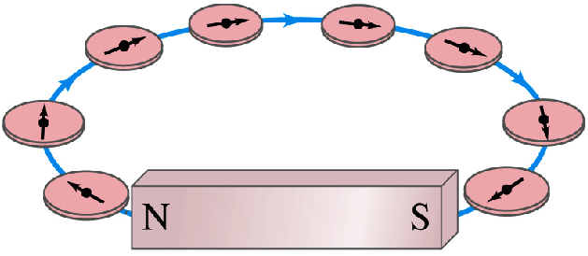
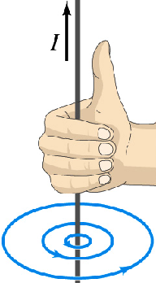
25-2. Magnetic Field Lines and Flux (P581)
1. The features of magnetic field lines
♣ No origin, no termination and no cross point(无头无尾不相交,闭合曲线);
♣ Wrap around with current与电流套连;
♣ Right-hand rule with current (与电流成右手螺旋关系)
2. Magnetic flux & Gauss’ law
Let —–number of magnetic field line threading area dA,

Slide 7
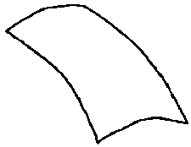
The flux of magnetic field intersects a closed surface:
(Gauss’ law of magnetic field)
In the absence of magnetic monopoles the magnetic flux threading a closed surface is zero.

Slide 8
25-3. Magnetic Force on Moving Charges
1. Lorentz’s force (P586)
The charged particles moving in magnetic field acted by magnetic force:
The force acting on a charged particle moving with velocity through a magnetic field is always perpendicular to and .
α
q
F=qvsinα (when α = 0,F=0),
Magnetic force only change moving direction W_{B}=0.

Slide 9
2. The motion of charged particle in uniform :
(1) Particle moves parallel to
q
+
, particle straightly move in constant velocity.
-
q
(2) Particle moves perpendicular to
F=qvB = C and radially directed.
q
+
—— Circular motion with constant speed in the plane of perpendicular to
q>0:
R
Radius of track:
q>0:
Period:
R
q
-

Slide 10
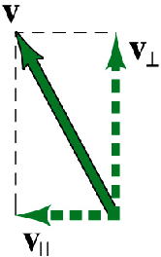
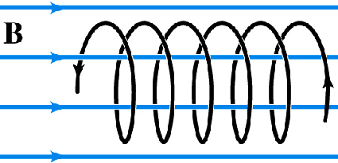
(3) Particle moves in an angle with (P587):
v//= vcosθ,
v⊥=vsinθ
h
Particle follows a spiral path (螺旋线运动).
Radius:
Period:
θ
+
q
Pitch(螺距):
Look at example 25-6 of P588 to learn about the phenomenon of aurora, please.

Slide 11
If a particle of charge q moves with velocity in the presence of both magnetic field and the electric field , it will feel a force
It is often called the Lorentz equation and is considered one of the basic equation in physics.
If no other external forces, then
From it one can determine the motion of particles.

Slide 12
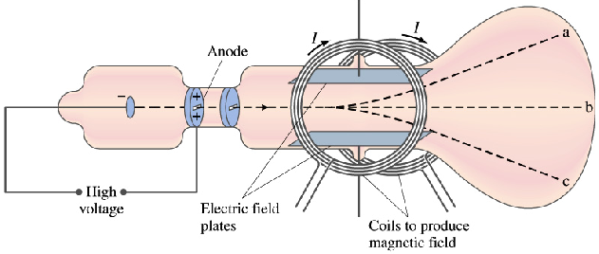
3. Samples of practical application
(1) Discovery and properties of electron (P592)
Both and can produce a force on a charged particle:
It can be used to measure the ratio m/q of the particles moving through Thomson’s apparatus.
电子比荷
Fig.25-29 in P593

Slide 13
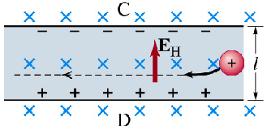
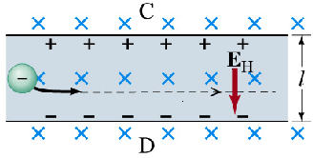
(2) The Hall effect (霍尔效应)(P594)
载流导体放在磁场中，磁场垂直于电流方向，则在磁场与电流垂直方向出现横向电势差。
It is called Hall effect, the electric potential arisen from it is Hall voltage.

Slide 14
What relation between V & I ?
d
-
-
-
-
-
-
-
-
-
O
-
-
-
-
-
-
V
l
I
+
+
+
+
+
O’
+
半导体类型判别
Hall effect can be used to find B, I, density, positive or negative and drift speed of charged carriers…

Slide 15
25-4. on a Current-carrying Wire (P605)
1. Magnetic force on a current
Freely choose a short length dl, cross area A, mass m, charge q, then the Lorentz’ force on each particle:
i
N=nA dl
(force on a current)
Note: where is external magnetic field.

Slide 16
Example:
A straight, horizontal length of copper wire has a current I=28A through it. What are magnitude and direction of the minimum magnetic field needed to suspend the wire (to balance ) on it? The linear density of wire is 46.6g/m.
Solution:
This is about 160 times the strength of Earth’s magnetic field.

Slide 17
Example:
A half-circular wire of radius R with current I is put in a uniform magnetic field as the figure shown, α=30°, find the magnetic force acted on the arc (此段圆弧电流受的磁力).
Solution:
α
uniform
For this case,
direction of magnetic force:

Slide 18
From equation
we can learn:
(1) The sum of magnetic force acted on a whole curved wire = the one of straight wire with same current connected from start to end points (均匀磁场中任意弯曲导线所受的磁场力=相同电流的直导线所受的磁场力).
(2) If points a and b overlapping, then l=0, F=0.
(均匀磁场中任意闭合导线所受的磁场力=0)
No magnetic force exerted on a current loop in a uniform magnetic field.
(3) Magnetic force is always perpendicular to the plane defined by length vector and magnetic field.

Slide 19
2. Force between two parallel wires (P605)
Two long parallel wires carrying currents exert forces (平行载流导线)on each other as the figure,
x
a
d
b
dl_{a}
dl_{b}
I_{a}
I_{b}
Think about how about the force between two antiparallel wire 平行反向载流导线之间的力怎样(方向、大小)?
—— repel each other!

Slide 20
To find the force on a current-carrying wire due to a 2nd current-carrying wire, first find the field due to 2nd wire at the site of 1st wire. Then find the force on 1st wire due to that field.
Parallel currents attract, and antiparallel currents repel.
Acting force exerted on the ab wire in unit-length:
It is the same for both wires of ab and cd.

Slide 21
The definition of the ampere (电流单位“安培”) (P607)
One ampere is defined as that current flowing in each of two long parallel conductors 1m apart, which results in a force of exactly of length of each conductor.
两无限长平行载流导线相距1m,通有相同电流,单位长互作用力为2×10 ⁻⁷ N时,导线内电流为1A.
Proof: when I_{a} =I_{b}=1A,
Hence,
Coulomb is then defined as being exactly one ampere-second: 1C = 1A· s.

Slide 22
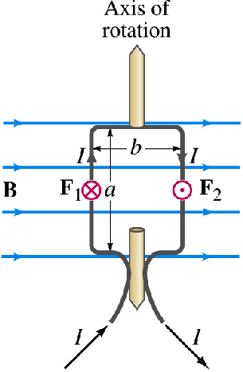
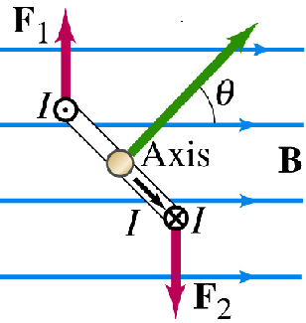
25-5. Torque on a Current Loop (P589-)
Magnetic force exerts on a current loop as the figure,
Torque (力矩) :
This formula, derived here for a rectangular coil, is valid for any shape of flat coil.
b

Slide 23
Introducing the magnetic dipole moment of the coil (线圈的磁矩). It is considered a vector:
The direction of is perpendicular to the plane of the coil consistent with the right-hand rule
It is also right for any shape coil of N loops immersed in a uniform magnetic field.
b

Slide 24
Another way to measure magnetic field:
Direction of :
the one of magnetic dipole moment when a coil is in stable-equilibrium.
Magnitude of :
SI unit of the torque:
[τ ]= T·A·m² =N·m

Slide 25
Magnetic potential energy (P590):
Recall that an electric dipole has potential energy when in ,
In order to rotate a current loop so as to increase .
we must do work against the force due to the magnetic field:
or, the work done by a magnetic torque is:
(1)

Slide 26
dW can also be written as:
That is,
(2)
so, it can be seen that the
work done by magnetic force on a current wire:
W = I Δ Φ

Slide 27
From equation:
(1)
A dipole is capable of doing work and possesses U.
As a convenience, U=0 is chosen as the axis of dipole is perpendicular to the , i.e. . Then
Look at P590!
That is,
The potential energy of magnetic dipole moment in the magnetic field (磁矩在磁场中势能）.
The torque on the dipole is zero whether & are parallel or antiparallel. So both orientations are equilibrium configurations. The parallel is one of stable equi., and the antiparallel is one of unstable.

Slide 28
Example:
A current of 0.5A exists in a circular coil of wire situated in a uniform B=0.5T. The coil has a mean radius of 5cm and contains 250 turns of wire. How much work is done by magnetic forces in rotating the coil from a position where to a position where .
.
Solution:
.
×
The magnitude of magnetic moment is:
×
To calculate the work done by magnetic forces, we may use one of following methods:

Slide 29
Method I:
Method II:
.
Method III:
.
×
×
Look at the examples given in page 590!

Slide 30
25-6. Biot-Savart’s Law & Applications (P613)
Electric currents create magnetic fields. This discovery by Oersted in 1820 opened up a new field of research.
A question arises: Is there a general relation between a current in a wire of any shape and the magnetic field around it?
Shortly after 1820 J. B. Biot and F. Savart (both are French physicists) developed what is known as the law of Biot and Savart—— gives a quantitative description of Oersted’s magnetic field in terms of the electric current.
1. Biot-Savart’s law

Slide 31
The current element Ids generates a magnetic field dB given by:
α
P
I
In SI unit:
Magnetic permeability constant in a vacuum (真空磁导率):
The principle of superposition of magnetic field, can be applied for a complete circuit:
(Biot-Savart law)

Slide 32
2. The application of Biot-Savart law
(1) A long straight wire (载流长直导线的磁场 P614)
The magnitude of the differential magnetic field produced at P by the current-length element Ids located a distance r from P is given by:
I
θ₂
θ
r =R /sinθ , s = -R cotθ
s
R
×
x
L
P
θ₁

Slide 33

Discussions:
①The magnetic field from all current element of straight wire are in the same direction and into the screen.
I
②For straight and infinite wire (无限长载流直导线), θ₁=0,θ₂=π,then
The case given in P614
—— The magnitude of magnetic field of infinite straight wire at a point with distance R is in inverse proportion to the distance.
I

Slide 34

(2) In a circular arc of wire (载流圆线圈轴线上的磁场)
As the figure, given I, R, x
θ
R
θ
x
0
x
p
I
The direction of is perpendicular to the plane made of Ids and r and .

Slide 35
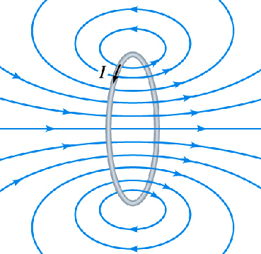
θ
R
Discussions:
θ
x
0
x
p
①At center O, x=0,
I
②For a circular arc of wire (一段圆弧电流圆心处的磁感应强度):
③The direction of is along the axis direction (right-hand rule) as right figure and Fig.26-18 in P615.

Slide 36
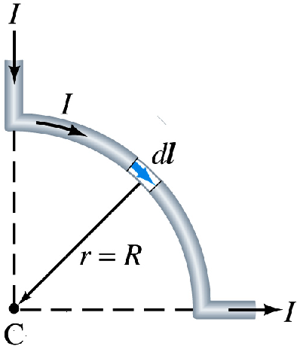
Example 26-11 of P616:
1
One quarter of a circular loop of wire carries a current I, and two straight sections whose extensions intersect the center C of the arc. Find at point C?
3
2
Solution:
For parts 1 and 2,
(direct into the screen)
(into the screen)
You may comparing with the calculation of electrostatic field.

Slide 37
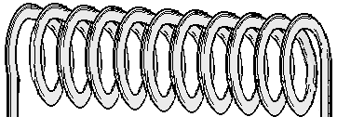
(3) A stretched-out solenoid (载流直螺线管轴线上的磁场)
The number of turns per unit length of the solenoid(单位长匝数) n. As vertical cross section (纵剖面) shown, (I, n, R, L, β_{1,} β₂ )
I
I
?
Think about: how to choose a current-element dI
choose dI=nIdx
Same direction!
x=Rcotβ , dx=Rcsc² β d β, R²+x²= R² csc² β
dx
L
.
.
.
.
.
.
.
.
.
.
.
.
.
.
.
β₁
.
β₂
P
β
×
×
×
×
×
×
×
×
×
×
×
×
×
×
×
x

Slide 38
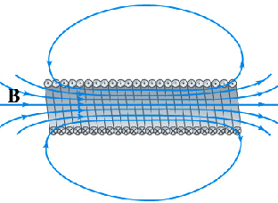
Explanations:
①Direction inside the solenoid is along the axis and right-hand rule as Fig.26-12.
②For a “infinitely long” solenoid, The at the axial line:
③B-x curve inside the solenoid (L=10R):
B
0.439
x
–5R
5R

Slide 39
25-7. Ampere’s Loop Law & Application
Andre Marie Ampere (1775—1836) French mathematician and physicist.
Ampere: All magnetic phenomena come from current (一切磁现象都起源于电流).
安培分子环流假说 : The source of magnetism of all natural-matter come from current（一切磁性的根源是电流）.

Slide 40
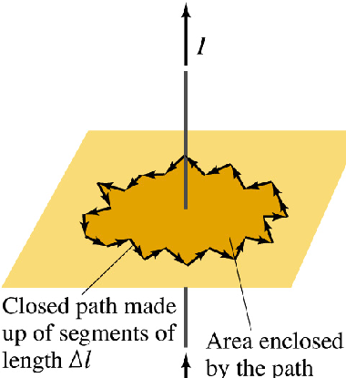
1. Ampere’s loop law (P607)
Any line integral of around a closed path was proportional to the current encircled by the path.
(in SI units)
在恒定磁场中，磁感强度沿任一闭合环路的线积分等于穿过该环路所围曲面的所有电流代数和的 倍
Note:
It is only hold for closed steady 闭合恒定 current.

Slide 41
Explanation:
Contributed by all current inspace.
Freely choose a closed loop and assign a positive direction.
Any differential elements on the L, along the tangent direction to the loop.
The net current encircled by the loop (与L套连的电流,回路所围面积截得)accord with right-hand rule (与L绕行方向成右螺电流取正).
In the above case,

Slide 42
Look at the description given in textbook of P608.
2. The application of Ampere’s law
It plays very important role in the theory of 电磁场。One can also use Ampere’s law to calculate with symmetrical distribution of current.
Main steps:
(1) Symmetry analyses (由I的分布，分析分布的对称性).
(2) Choose a loop (使回路上各处B相等，方向特殊，从而可从回路积分中提出B).
(3) Put into the law and calculate B.

Slide 43
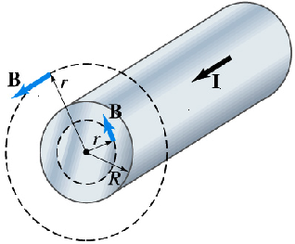
Example:
Find the inside and outside a long straight wire of radius R and uniformly distributed current I over a cross section of the wire 长直圆柱形载流圆柱体(电流I 均匀分布在圆柱的横截面内)内外的磁场.
Solution:
Cylindrical symmetry——P609
Choose a circular loop L₁ with r > R,

Slide 44
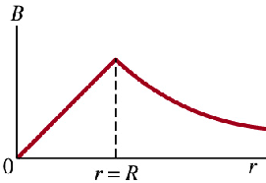
i
r
L₁
r
L₂
Choose a circular loop L₂ with r < R,
R
L₂
r
?
Can you draw the curve of Distribution of in whole space

Slide 45
In the similar way one may find (长直圆柱面载流导线内外的磁场) as figure:
I
r
= 0
L₂
B_{in}=0
Compare with produced by a current i in a long straight wire,
B
0
R
r
?
Can we find the result of finite long straight wire (有限长载流直导线) by using Ampare’s law

Slide 46
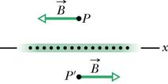
Example:
Solution:
Plane symmetry
It is a uniform field, independent of position r
在无限大均匀平面电流两侧的磁场均为均匀磁场，并且大小相等,方向相反。

Slide 47
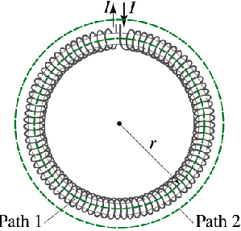
Example:
Magnetic field of a toroid (载流螺绕环内的磁场), given i, N, R₁ , R₂ .
Solution:
From symmetry, the lines of form concentric circles inside the toroid, directed as figure,
Choose concentric (同心) circle loop L (R₁ < r < R₂ ),
R₂
R₁
(Right-hand rule direction)

Slide 48
Discussion:
(1) In contrast to the situation for a solenoid, B is not constant over cross section of a toroid. But if its cross area is relatively small, then
It is as same as the expression of the one of long solenoid.
(2) so the magnetic field of toroid is limited in its interior.

Slide 49
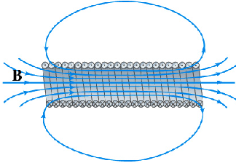
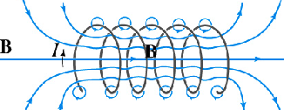
Example:
Find inside a “infinitely long” solenoid (载流长直螺线管内部的磁场)(The number of turns per unit length of the solenoid n and total number of coils N).
Based on the feature of the distribution of , we choose a rectangular loop abcd,
Solution:
at paths ad, bc, and dc,
B=0
a
b
d
c
l

Slide 50
25-8. Interaction between Magnetic Field and Dielectrics Magnetic Materials
1. Classification of magnetic materials
When the interior of a solenoid is filled with some material of relative permeability μ_{r} (相对磁导率),
Paramagnetism (顺磁质)
Diamagnetism (抗磁质)
Ferromagnetism (铁磁质)

Slide 51

2. Magnetization(磁化)of magnetic materials
When the interior of a solenoid is fully filled with some isotropic material μ_{r} , it will be magnetized (长直螺线管内部充满均匀的各向同性介质，将被均匀磁化).
Taking the paramagnetic material as an example,
each molecular in it is equivalent to a loop current:
Cross area of solenoid

Slide 52
To express the extent to which a given medium is magnetized, a vector quantity, magnetization 磁化强度, is introduced:
Take notes!
The unit of is A/m.
It can be proved,
and
The net bound current enclosed in a closed loop L equals to the circulation of magnetization along the closed loop.

Slide 53
3. Circulation theorem with magnetic materials
Let,
then,
The circulation of along any closed loop equals to the algebraic sum of free current encircled by the closed loop L —— Theorem of circulation .

Slide 54
Explanations:
(1) If the magnetic material were not present, then the above equation reduce to the Ampere-loop law in vacuum.
(2) For isotropic medium,
where μ is the permeability of magnetic materials.
(3) One may compare with , which is another supplementary physical quantity.
(4) The unit of in SI system is A/m.
(5) If with symmetry in distribution of free current,
then

Slide 55
Example:
A toroid is fully filled with magnetic medium, μ=5×10⁻⁴ T·m/A, n=10³/m, I=2A. Find: interior the medium.
Is the medium paramagnetism or diamag~ or ferromag~?
Solution:
So it is ferromagnetism.
R₂
R₁

Slide 56
As same as the one of long solenoid.

Slide 57
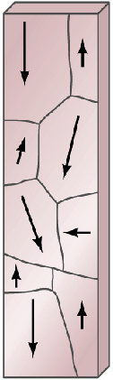
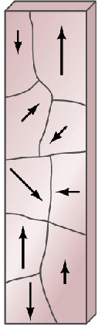
Ferromagnetism (P616):
Iron (and a few other materials), , can be made into strong magnets —— ferromagnetism.
Magnetic domains (磁畴):
A ferromagnetic material will, in its normal state, be made up of a number of magnetic domains which are tiny regions (about 10⁻⁴m) .
Under ,the domains are gradually aligned in the direction of and finally reach saturation.

Slide 58
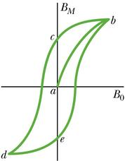
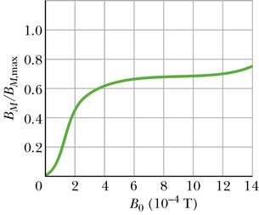
Magnetization curve (磁化曲线) (P619):
Hysteresis loop (磁滞回线)(P619):
Heating a magnetic too can cause a loss of magnetism. Above a certain temperature known as the Curie temperature (1043 K for iron), a magnet cannot be made at all.

Slide 59
The problems of chapter 25:
8, 9, 11, 20, 27, 28, 33, 35, 36, 56, 68
The problems of chapter 26:
14, 15, 23, 26, 27, 30, 31, 33, 36, 37, 40, 45, 51

